Slide 1





Retail Sales Forecast
WALMART
Time Series
Notes:
It’s quite clear that sales Forecasting is an important factor in the many decisions a company makes throughout the course of their fiscal year. And for this reason, my final project examines Retail Sales Forecasting for Walmart.

Slide 2


OBJECTIVE
WHAT:
Predict Weekly Sales Performance (Kaggle Data)
HOW:
Work with Sales Data – Retail Branch level
Cluster Branches based on Region attributes
Perform Time Series Forecasting on Clusters (predict cluster weekly sales)
TOOLS:

Slide 3
Perform Clustering
Regional Attributes (per store, per week)
Avg. Temperature
Avg. Fuel Price
Consumer Price Index
Unemployment (%)
Methodology
Aggregate Data for each Store
K-Means Clustering (Euclidean distance)
4 clusters
Clustering | Interpret Clusters | Time Series Analysis | Predictions

Slide 4
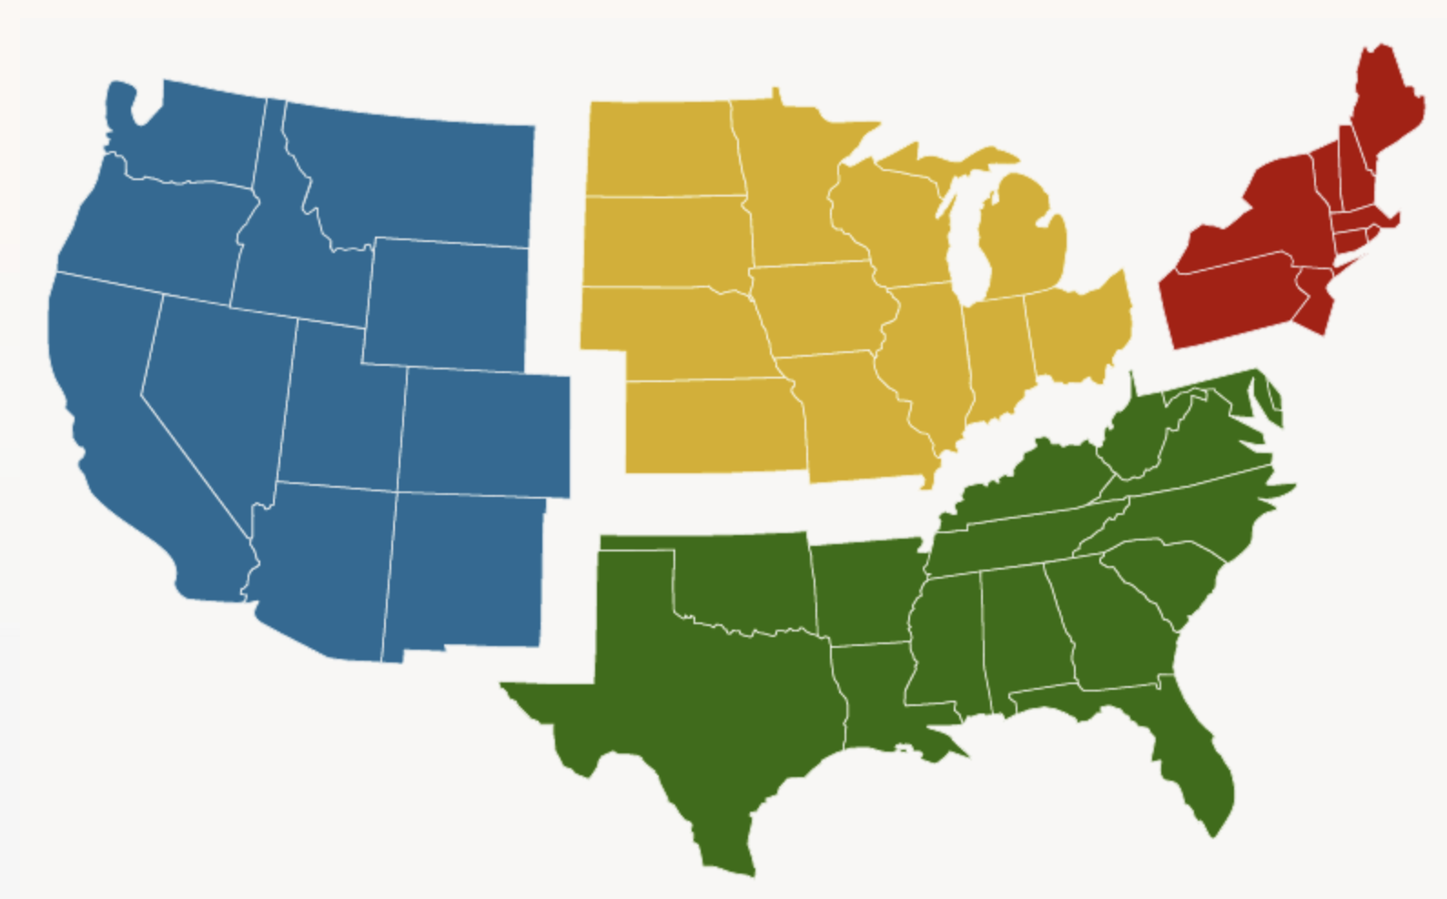
Interpret Clusters
Store Cluster 2:
Highest Avg. Regional Temperature: 67ºF
Lowest Avg. Consumer Price Index (CPI): 128
Highest Unemployment: 10.5%
Lowest Sales Cluster: $7.5M avg. weekly sales
Clustering | Interpret Clusters | Time Series Analysis | Predictions

Slide 5
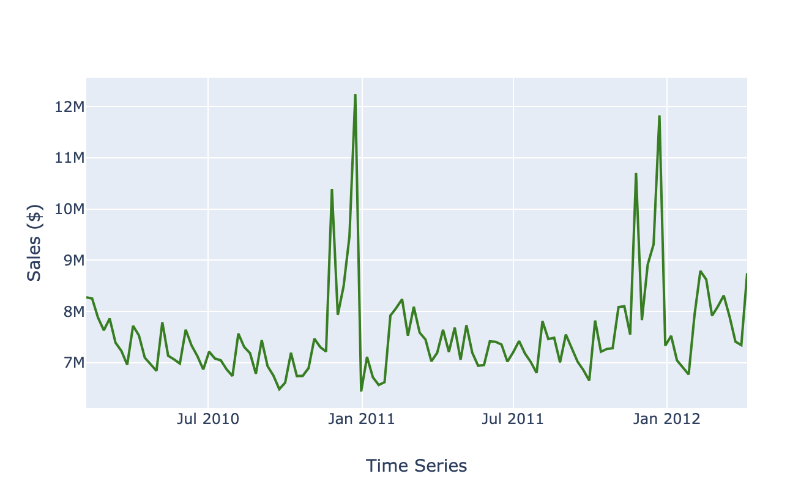
Time Series: Stationarity
Store Cluster #2:
Strong seasonality
November – Black Friday
December - Holiday Season
Augmented Dickey-Fuller Test
ADF = -4.95
P-value < 0.01
No Unit Root (95% confidence)
STATIONARY
Store Cluster #2 Sales
Clustering | Interpret Clusters | Time Series Analysis | Predictions
Notes:
Several components to a time series analysis – first being: STATIONARITY. Is the mean and variance constant across time?
If not, we’d need to difference the series to make it stationary.
Augmented Dickey-Fuller Test:
Null hypothesis that there is a unit root at some level of confidence – therefore not stationary

Slide 6
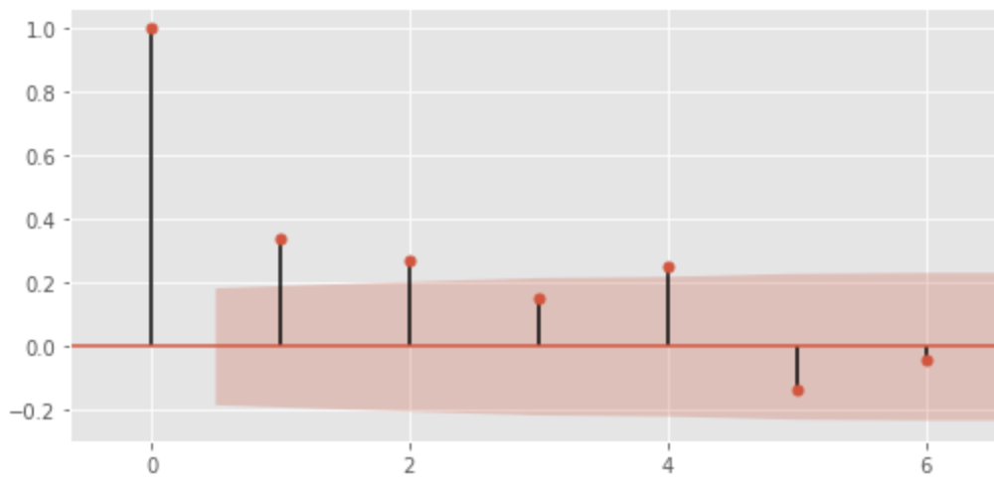
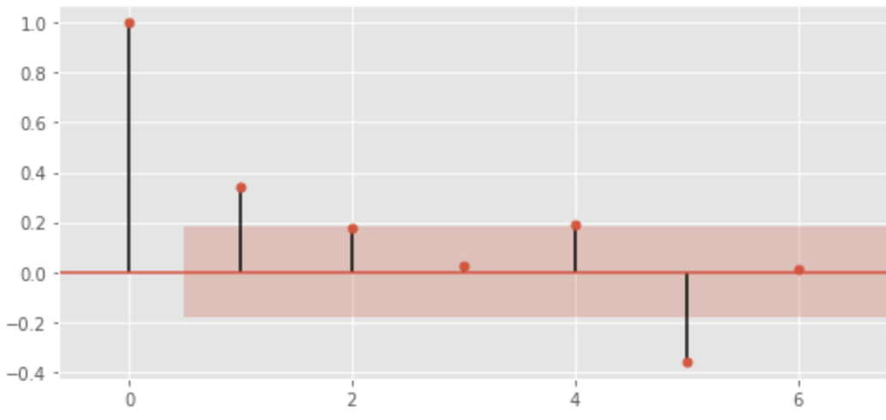
Time Series: Auto-Correlation
Auto-Correlation (ACF)
2 lags w/ significant AC
MA = 2 (moving average term)
Partial Auto-Correlation (PACF)
1 lag with significant PAC
AR = 1 (auto-regressive term)
Clustering | Interpret Clusters | Time Series Analysis | Predictions
Notes:
AUTO CORRELATION (ACF)
correlation between a variable at a given time and previous time lags of itself
Used to identify the number of MA (moving average) term of a time series
Moving Average:
Looks at the weighted average of previous error terms
TWO lags are deemed significant
PARTIAL AUTO CORRELATION
Amount of correlation between a variable at a given time, and a time lag of itself, that is not explained by correlations at all lower-order-lags
Distinct relationship between given time lag and time 0
Used to identify the number of AR (Auto Regressive) term of a time series
Autoregressive:
Looks at the weighted average of previous sales values
In this case, only ONE lag (timestep) is significant

Slide 7
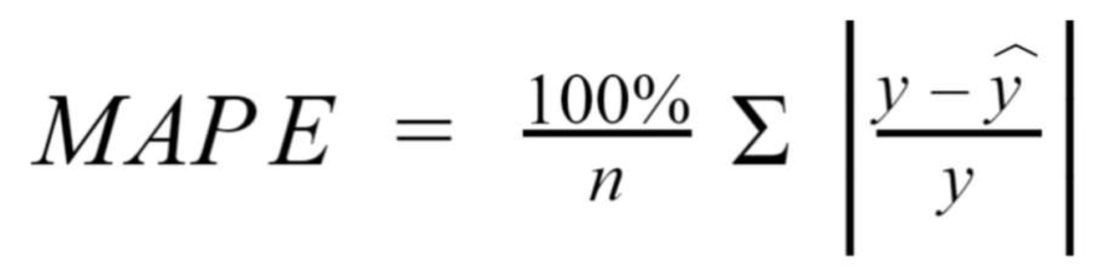
Time Series: Model Selection
SARIMAX Model (exogenous = “Holiday Week” dummy variable)
Grid Searched Parameters
Minimize Mean Absolute Error (MAE)
Represented as % of Mean Sales
Avoided MAPE to evenly penalize errors at all points in time
MAPE (under forecast instance): ≯ 100%
MAPE (over forecast instance): unbounded (i.e. can be > 100%)
Minimizing MAPE could lead to a biased low forecast
Final Model
Model Parameters | AIC | 1 week (MAE%) | 1 month (MAE%) | 3 months (MAE%) | 7 months (MAE%)
(1,0,2)x(1,0,0)₅₂ | -139.59 | 4.47% | 4.05% | 3.25% | 2.87%
(1,0,2)x(0,1,0)₅₂ | -219.56 | 2.79% | 4.96% | 3.35% | 3.12%
Clustering | Interpret Clusters | Time Series Analysis | Predictions
Notes:
Due to seasonal component of data….proceeded with SARIMAX model with a “Holiday Week” dummy variable as an exogenous feature.
MAPE penalizes over-forecasting compared to underforecasting.

Slide 8
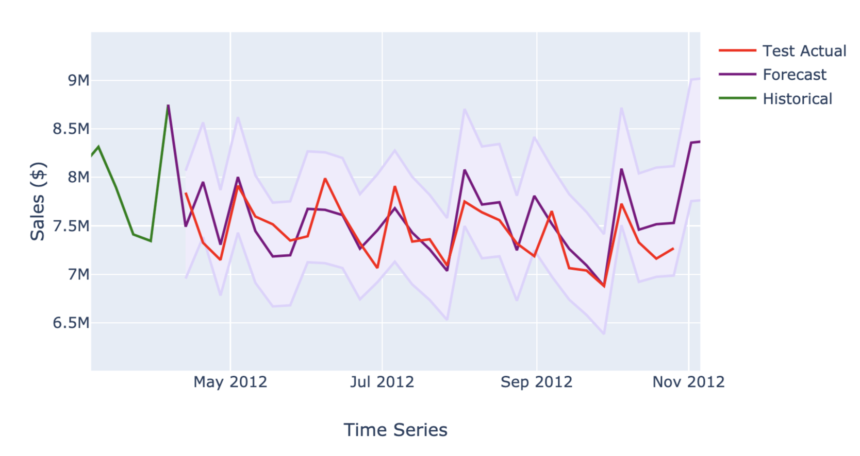
Time Series: Predictions
Cluster #2 Sales Forecast
95% Confidence Interval
Clustering | Interpret Clusters | Time Series Analysis | Predictions

Slide 9
